Slide 1


BUILDING A SCALABLE WEB APPLICATION ON AWS
Leveraging AWS Services for Scalability and Performance

Slide 2





Introduction:
building a scalable and reliable web application that works as a video platform as same as youtube or netflix. With the use of S3, html, css.

Slide 3

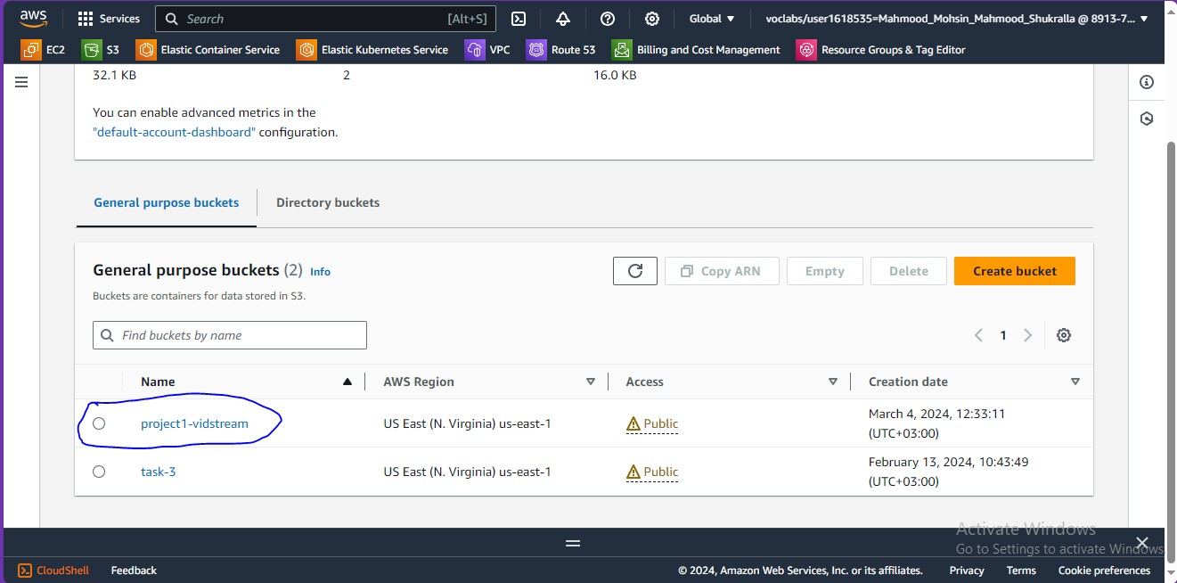
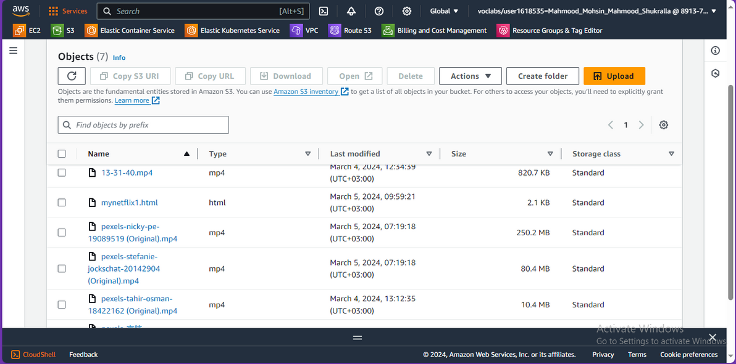
-----> making a bucket
adding objects to the bucket <-----

Slide 4

AMAZON S3:
AMAZON S3 (SIMPLE STORAGE SERVICE) IS A HIGHLY SCALABLE AND RELIABLE CLOUD STORAGE SERVICE PROVIDED BY AMAZON WEB SERVICES (AWS). IT ALLOWS YOU TO STORE AND RETRIEVE ANY AMOUNT OF DATA FROM ANYWHERE ON THE WEB. S3 IS COMMONLY USED FOR STORING STATIC ASSETS SUCH AS IMAGES, VIDEOS, DOCUMENTS, AND OTHER FILES.
AND HERE IS WHAT I DID USING S3 ---->

Slide 5
IMPLEMENTATION DETAILS:
1- making a website using HTML, CSS by a adding a heading of the title name of the web application
2- I made a bucket and applied objects to it in S3. Those objects are some videos downloaded to add it to the website
3- add the videos to the website and change the design of the website and make it more interesting
4- test the website...
5- All Done!!

Slide 6

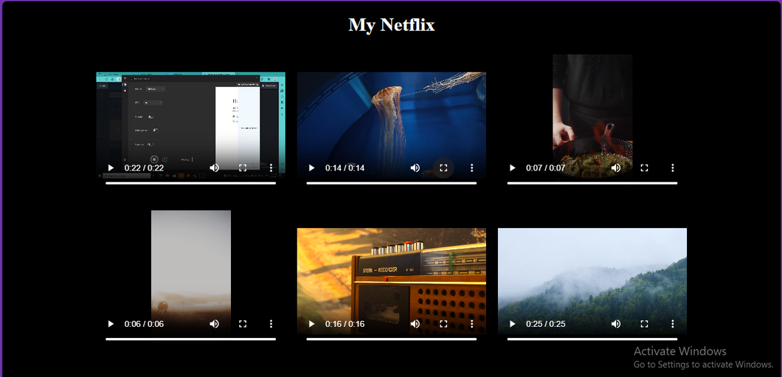

SCALABILITY AND PERFORMANCE TESTING
The web application is scalable and has low latency and is well designed and can handle loads!!
website:https://project1-vidstream.s3.amazonaws.com/mynetflix1.html

Slide 7


MY NETFLIX
Basically my project name is My Netflix it is a web application that illustrates videos and can be used like youtube or netflix, etc. for the moment I used Amazon S3 service as my main service to develop this project but I have a future view of making an application that competes on the field by using more services beside S3.

Slide 8
THANK YOU!
Done By: Mahmood Mohsin 12CCP

